Slide 1
Plant species identification using computer vision
Data Science capstone, fall 2018
Jack Crum

Slide 2
Introduction
Endangered Species Act of 1973: Section 2(a)(2)
“The policy of Congress that all Federal departments and agencies shall seek to conserve endangered species and threatened species and shall utilize their authorities in furtherance of the purposes of this Act.”
Expenditures on endangered species conservation plans total more than $800 million annually and include 218 plant species
Department of Defense (DoD) has the highest density of endangered species of any other federal agency, with 340 out of 420 large military installations requiring active conservation management plans to protect 492 listed species (274 animals, 218 plants).

Slide 3
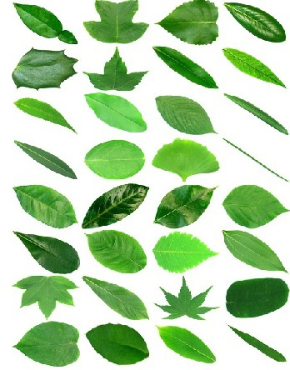
Problem statement
Large amounts of available images and data are ignored or overlooked due to lack of automation, manpower, and resources
Previously developed CNN models have good accuracy with leaves on white backgrounds (Flavia Dataset), not tested with natural background
The most popular current applications for planet identification still suffer from inabilities to deal with cluttered backgrounds and have single uploads
Project focus is to save conservation resources by developing a simple automated system for uploading large folders of images, identifying species in images, and sorting based on prediction

Slide 4
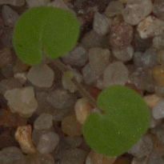
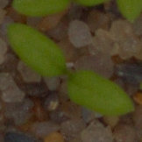
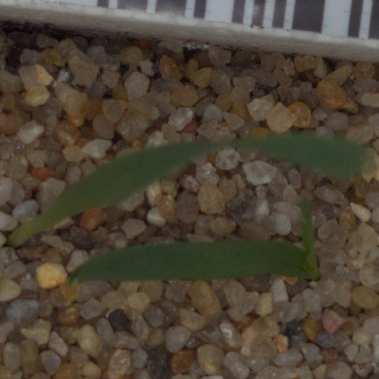
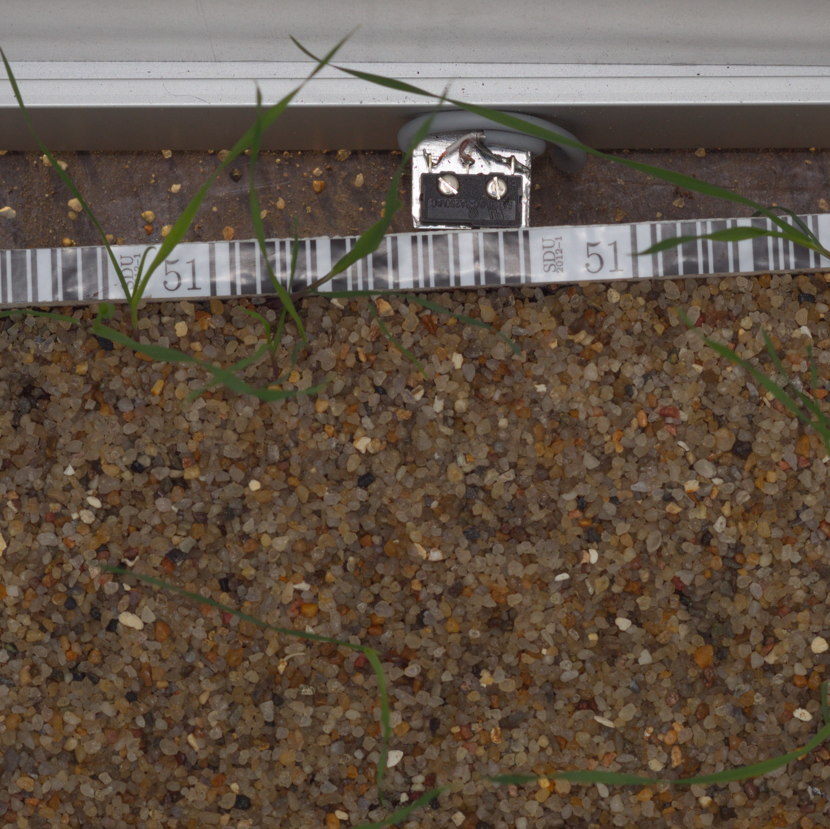
DataSet
Kaggle Plant Seedlings Classification Dataset
12 species in pre-split training/testing datasets
4750 training images
794 testing images
Testing set is not labelled
Uneven class distribution

Slide 5
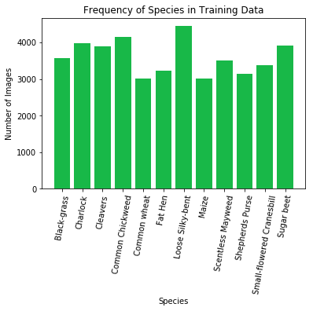
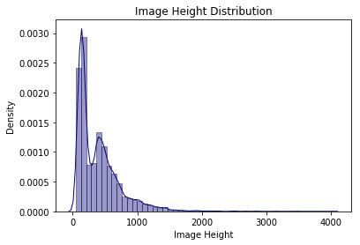
Data Augmentation
All Images were rotated 90˚, 180˚, and 270˚
Some were horizontally flipped and vertically flipped to create more uniform class distributions
50867 total images from original training set: 32429 training,10809 testing, 7629 validation

Slide 6
Image preprocessing: Normalization
Rescaling pixel values from [0,255] to [0,1]
Ideal for each feature to have a similar range so that the gradients in backpropagation don't go out of control

Slide 7
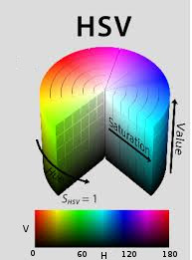
Image preprocessing: Masking
Change colorspaces from BGR (Blue, Green, Red) to HSV (Hue, Saturation, Value)
In OpenCV, Hue range is [0,179], Saturation range is [0,255] and Value range is [0,255].
Threshold the HSV image for a range of green color
Chosen range: (40, 0, 0) to (110, 255, 200)

Slide 8
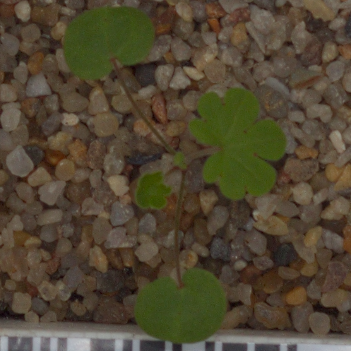
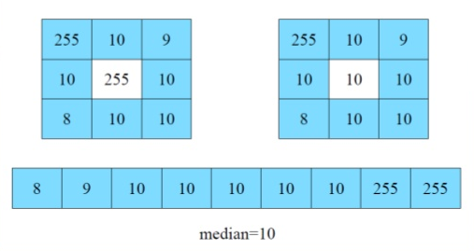
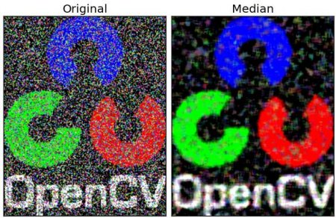
Image preprocessing: Median Blur
Computes median of all pixels under the kernel window and central pixel is replaced with this value
Highly effective in removing salt-and-pepper noise
15x15 kernel chosen for images

Slide 9
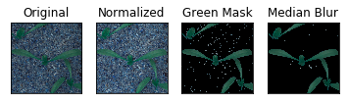
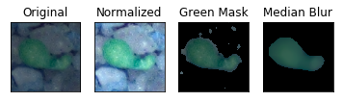
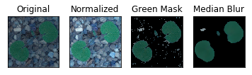
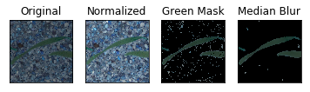
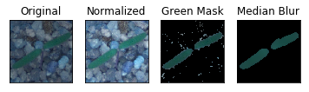
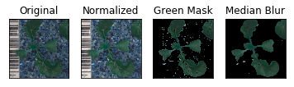
Image Preprocessing Results

Slide 10

Neural Networks
Convolutional Neural Network
Convolutional Layers
Stride over image with various number of weight matrices to detect edges and patterns
Activation
ReLU (
Max Pooling Layers
Shrink images based on maximum value in kernel
Flatten
Flatten into 1d array
Fully Connected Layer
Fully connected layer
Softmax Output
Class probability

Slide 11
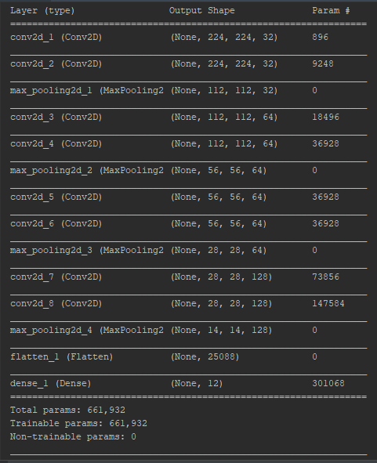
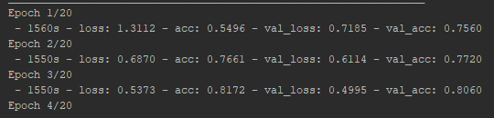
Initial CNN Results
14 layers CNN with 8 convolutions
80-81% training and validation accuracy after 3 epochs
Long training time (~26 minutes per epoch)

Slide 12
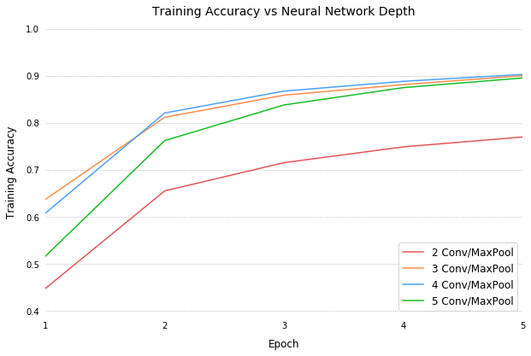
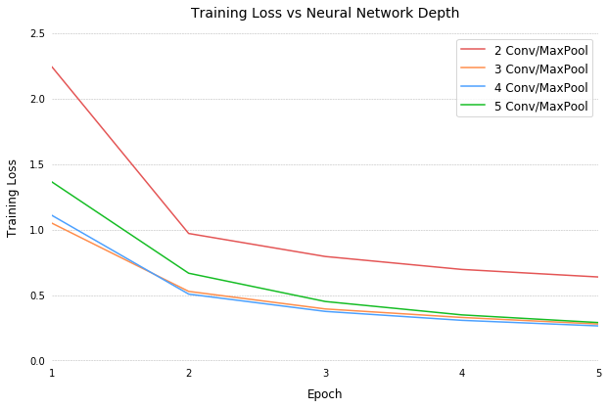
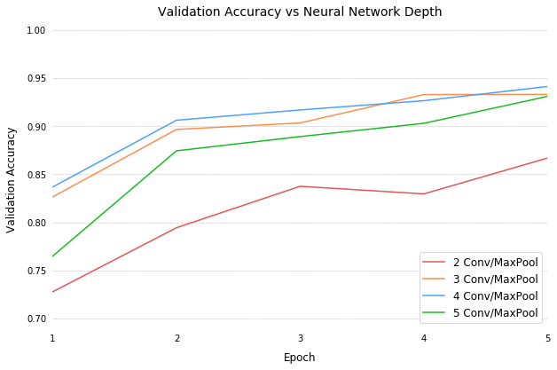
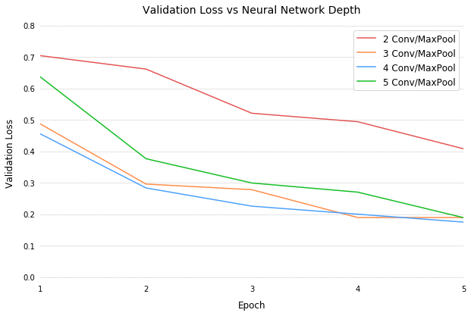
Network architecture: Layers
Conv Block:
1 Convolution Layer
32 Feature Maps
5x5, 3x3 Kernels
Batch Normalization
ReLU Activation
Max Pool (2x2)
Architecture:
Conv Blocks
Flatten Layer
FC1 Layer (128x1)
Dropout(0.5)
FC2 Layer (12x1)
Dropout(0.1)
Softmax Activation

Slide 13
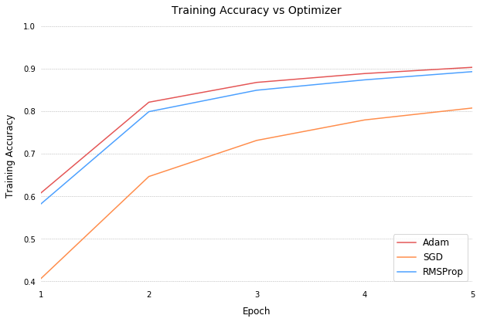
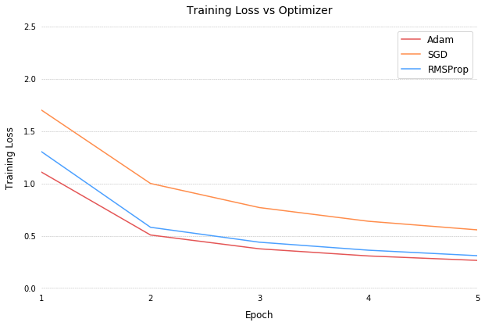
Network architecture: Optimizer
Adam
Adaptive Moment Estimation
Combines advantages of AdaGrad and RMSProp
Makes use of the average of the second moments of the gradients (the uncentered variance)
The algorithm calculates an exponential moving average of the gradient and the squared gradient
SGD
Stochastic Gradient Descent
Maintains a single learning rate for all weight updates that does not change during training.
RMSProp
Root Mean Square Propagation

Slide 14
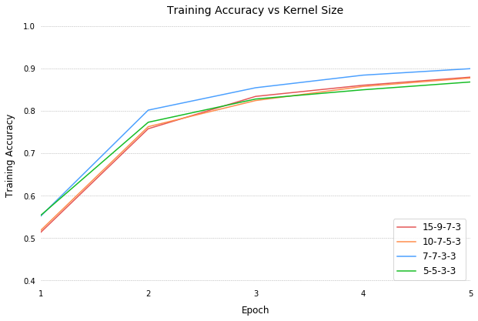
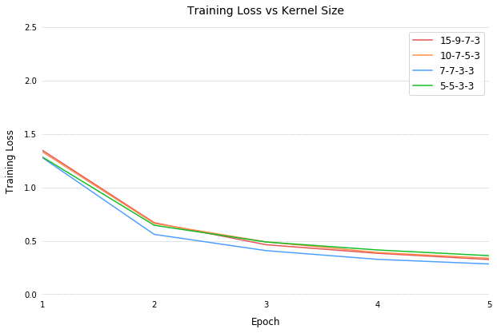
Network architecture: kernel size

Slide 15

Flask Application
Python micro web framework to develop web applications
Connect frontend JavaScript with backend Python using templates and connect pages using route decorators
Upload files through upload bar, run each image in file through model, output graphics, and sort on local file system
Often used with MongoDB, possibly use for storing image metadata for future analysis

